Slide 1
Applying Design Thinking
Developing a Fake Job Email Detection App

Slide 2
Introduction
Fake job scams are increasingly targeting job seekers by posing as legitimate employment opportunities. This presentation explores the importance of email detection to combat these scams and enhance job seekers' security.

Slide 3
01
Introduction

Slide 4
Overview of fake job scams
Fake job scams lure unsuspecting job seekers into fraudulent schemes. They often advertise nonexistent jobs online, tricking candidates into revealing personal information or sending money for supposed training or application fees.

Slide 5
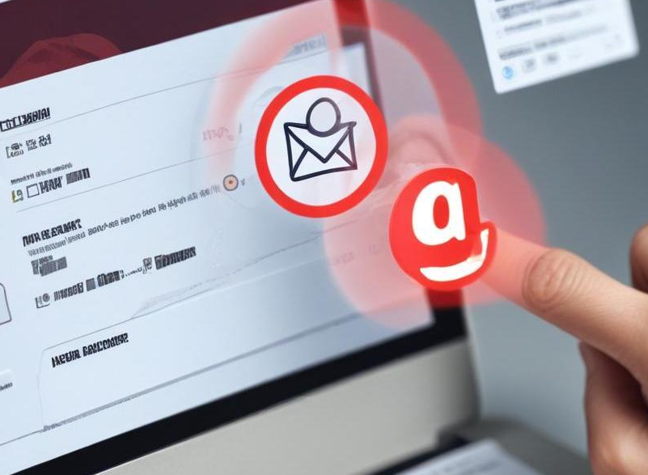
Importance of email detection
Email detection tools are critical in identifying potential scams before they reach job seekers. By analyzing email content, sender reputation, and suspicious links, these tools help protect users from fraudulent activities.

Slide 6
Current challenges faced by job seekers
Job seekers face numerous challenges, including overwhelming numbers of job postings, difficulty verifying legitimacy, and a lack of resources for identifying scams. These obstacles can lead to financial loss and emotional distress.

Slide 7
02
Empathize

Slide 8

Real examples of job seekers affected
Many job seekers have shared experiences where they were misled by fake job offers. These stories highlight the urgency for solutions to help recognize and avoid such scams.

Slide 9
Emotional and financial impact
The emotional toll of falling victim to job scams includes anxiety and loss of confidence. Financially, victims often face dire consequences like loss of savings or incurring debt to pay for fake job-related costs.

Slide 10
Common patterns in scams
Fake job scams often feature common traits, such as vague job descriptions, promises of high pay for little work, and requests for personal information without formal interviews. Recognizing these patterns is vital for prevention.

Slide 11
03
Define

Slide 12
Need for detection tools
There is a significant need for effective detection tools that can analyze job listings and emails, providing job seekers with a safety net against fraud. These tools can help verify job legitimacy in real time.

Slide 13

Gap in current job application process
The current job application process often lacks robust mechanisms to protect candidates from scams. Integrating detection tools into existing platforms can bridge this gap, providing necessary safeguards.

Slide 14
Target audience for the app
The primary target audience for the fake job email detection app includes job seekers, particularly recent graduates and professionals looking for new opportunities. Additionally, recruitment agencies and human resource departments can benefit from utilizing the app to filter out fraudulent job postings. Understanding the needs and concerns of these users is crucial for developing effective features and ensuring user satisfaction.

Slide 15
04
Ideate

Slide 16
Email analysis features
The app will incorporate email analysis features that utilize machine learning algorithms to assess the legitimacy of incoming job-related emails. It will analyze the sender's email address, check for common scam language, and evaluate attachments for potential malware, thereby providing users with a comprehensive risk assessment of each email.

Slide 17
Risk detection methods
Risk detection methods will include various techniques such as blacklisting known scam domains, verifying employer details through automated checks, and utilizing pattern recognition to flag emails with characteristics of previous scams. Implementing these methods will help minimize false negatives and enhance overall security.

Slide 18
User alert systems
The app will feature real-time alert systems to notify users of high-risk emails. Alerts will be customizable, allowing users to set thresholds for what they consider suspicious. Push notifications and in-app alerts will ensure that users are promptly informed and can take immediate action to protect themselves.

Slide 19
05
Prototype

Slide 20
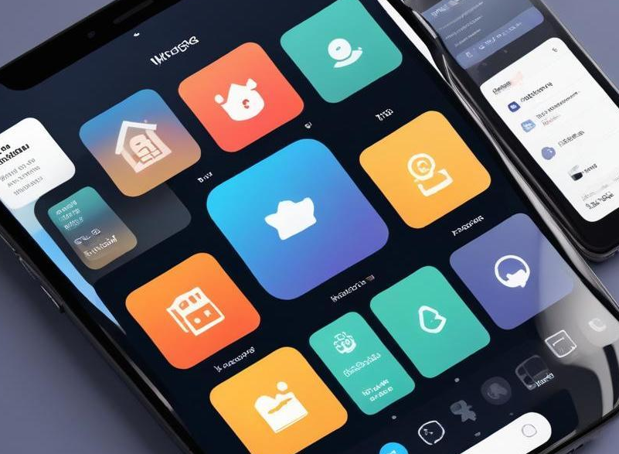
Home screen design
The home screen design will prioritize user experience by offering a clean layout with easy navigation. Users will see a summary of their recent emails, alerts for potential scams, and quick access buttons to analyze new emails or messages. The design will be user-friendly to ensure accessibility for all demographics.

Slide 21
Analysis interface
The analysis interface will provide detailed insights into each email's legitimacy. Users can see a breakdown of the analysis process, including results from risk assessments and suggestions for how to handle suspicious messages. A simple and intuitive design will facilitate ease of use, encouraging user engagement.

Slide 22
Database management layout
The database management layout will enable users to save and categorize emails for future reference. Users can access a history of analyzed emails, view flagged items, and manage their alert preferences. A searchable database will enhance user functionality, making it easy to navigate through past interactions.

Slide 23
06
Test

Slide 24
User interaction feedback
User interaction feedback will be collected through surveys and usability testing sessions. This information will help identify areas of improvement and refine the app's features based on real-world user experiences. Continuous feedback loops will ensure the app evolves to meet user needs.

Slide 25

Identifying usability issues
By analyzing the data from user interactions, the app's development team will pinpoint usability issues that hinder user experience. This process will involve observing user behavior, collecting reports, and making data-driven decisions to enhance functionality and intuitiveness.

Slide 26
Enhancing user experience
To enhance user experience, updates will be rolled out based on feedback, focusing on simplifying navigation, improving response times, and adding new features that meet users' expectations. A continuously improving app will keep users engaged and increase their trust in the product.

Slide 27

Conclusions
In conclusion, the development of a fake job email detection app utilizing design thinking principles will significantly empower job seekers in their search for legitimate employment. By empathizing with users, defining their needs, ideating effective solutions, prototyping innovative designs, and rigorously testing, we can create a tool that addresses the growing issue of job scams and enhances the overall job-seeking experience.

Slide 28
Thank you!
Do you have any questions?
rx.joseph._
_omalur_dhanush_007_
_hunter_2006
Levi_the_ackerman_15
+91 620 421 838

